Slide 1

Wine Analysis & Recommendation System
MGMT 590: BigData & MLOps Final Project (Group 14)
Shreya Sunil Malvankar | Meghna Ashok Advani | Atharva Nimbalkar | Kashika Chopra
smalvank@purdue.edu | advani3@purdue.edu | animbal@purdue.edu | chopra72@purdue.edu

Slide 2
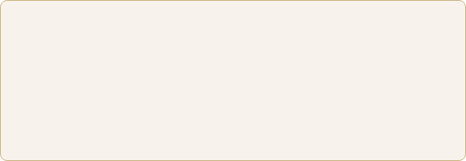
PROJECT OVERVIEW
A comprehensive Big Data Analytics and MLOps project built on a real-world wine review dataset built to bridge MongoDB Atlas to Databricks for advanced wine analysis and recommendation system.
Key features
129,971 Tasting Records
Distributed Spark Compute
Spark MLlib NLP Modeling
MLflow Experiment Tracking
Primary Goal
Demonstrating proficiency in distributed data engineering and MLOps by transforming raw NoSQL data into a production-ready model.

Slide 3
DATASET DESCRIPTION
The dataset consists of 129,971 wine review records sourced from the Wine Enthusiast magazine and stored in a MongoDB Atlas cluster (database: wine, collection: tastings)
Field | Data Type | Description
points | Integer | Wine quality score rated by reviewer (80–100 scale)
price | Float | Retail price of the wine bottle in USD
title | String | Full title of the wine including vintage year and label
variety | String | Grape variety used (e.g. Pinot Noir, Chardonnay)
description | String | Free-text tasting notes written by the reviewer
country | String | Country of origin of the wine
province | String | Province or state of production
region_1 / region_2 | String | Specific geographic wine-growing region
winery | String | Name of the producing winery
designation | String | Specific vineyard or reserve label designation
taster_name | String | Name of the wine reviewer/taster
taster_twitter_handle | String | Twitter handle of the reviewer

Slide 4

PROBLEM DEFINITION
From producers and retailers to consumers, each party involved lack scalable, objective tools to identify quality patterns, benchmark pricing, and predict whether a wine will be considered high-quality before purchasing.
Core Research Question
How can a scalable recommendation engine surface the best wines for any given flavor profile and budget constraint?
Can the textual content of a wine's description alone predict whether it will be rated as high-quality (≥87 points)?
How can a scalable recommendation engine surface the best wines for any given flavor profile and budget constraint?

Slide 5

BUSINESS CONTEXT
Data-driven curation allows for the identification of "under-the-radar" wines that score highly but are priced for high-volume sales.
$340B
Curation
Insights
GLOBAL WINE MARKET
HIGH-STAKES DECISIONS
COMPETITIVE EDGE

Slide 6
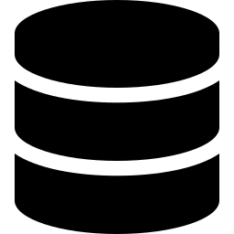






SYSTEM ARCHITECTURE
End-to-end pipeline: MongoDB wine reviews → Production ML recommendation system
ML & APPLICATION LAYER
01 DATA SOURCE
05 ML PIPELINE
MongoDB Atlas
Spark MLlib · 6-Stage NLP Pipeline
129,971 wine review records · database: wine · collection: tastings
Tokenizer → StopWords → NGram → HashingTF → IDF → LogisticRegression
02 DATA INGESTION
PyMongo → Pandas → Spark DataFrame
Structured ingestion · schema validation · temp SQL view registration
06 EXPERIMENT TRACKING
MLflow · MLOps Layer
AUC = 0.9086 · versioned artifacts · run metadata · model registry
03 DISTRIBUTED PROCESSING
Apache Spark on Databricks
Data cleaning · feature engineering · Spark SQL aggregations
04 FEATURE STORAGE
07 APPLICATION LAYER
Columnar Parquet · Unity Catalog Volume
Live Recommendation Engine (PySpark)
Columnar compression · predicate pushdown · reduced query latency
Inputs: flavor keyword + max price · Output: Top 10 wines by critic score

Slide 7
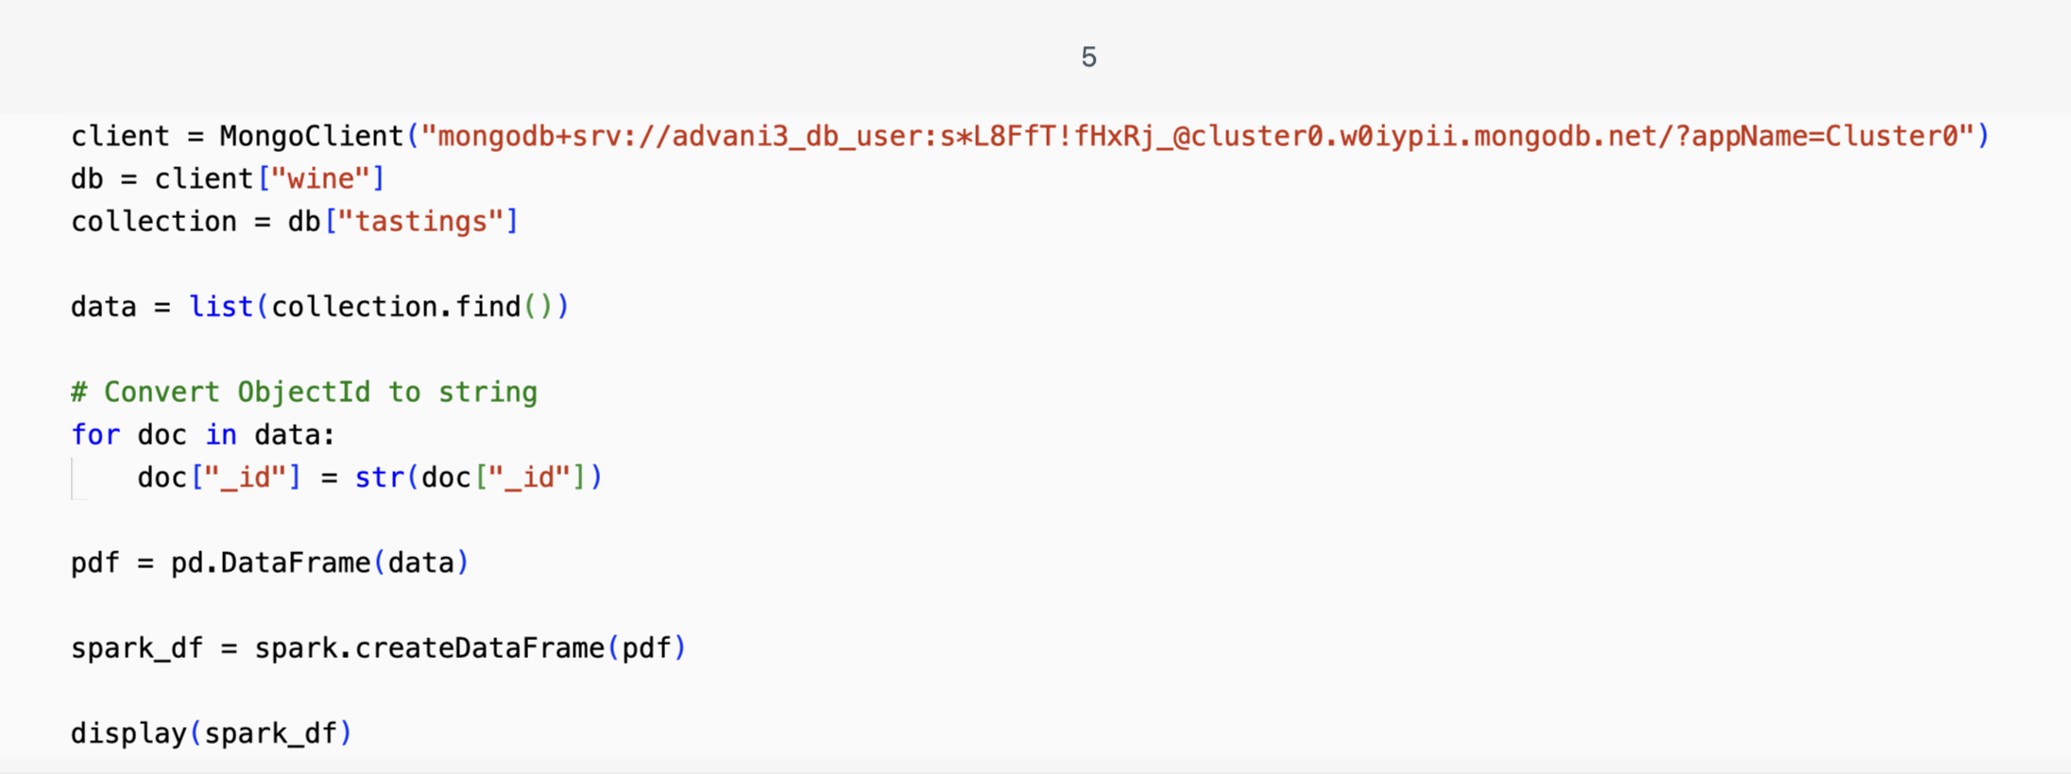
INGESTION WORKFLOW
The Spark DataFrame was immediately registered as a temporary SQL view (wine_raw) to enable Spark SQL querying throughout the project. Schema validation was performed using Spark's printSchema(), confirming 14 fields with correct inferred types.

Slide 8
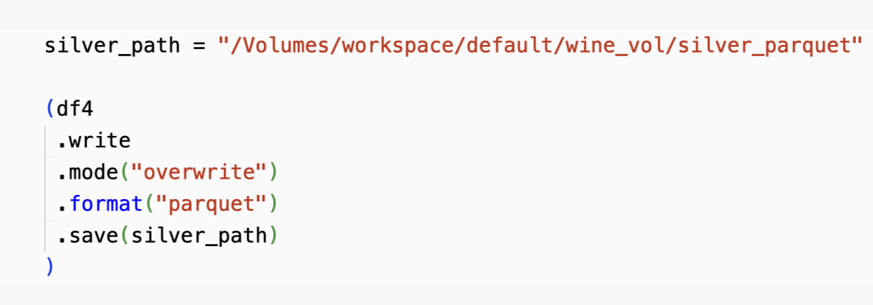
FEATURE ENGINEERING & COLUMNAR STORAGE
NLP Scrubbing | Binary Labeling | Bucketing | Null Management
Lowercasing and punctuation stripping using Spark Regex for clean modeling tokens. | Threshold defined at 87 Points to create a statistically balanced prediction target. | Grouping high-cardinality varieties (outside Top 20) into an 'Other' category. | Implemented price_missing binary flags to preserve signals for outlier analysis.
Data is stored in the Databricks Unity Catalog Volume for high-performance retrieval
Columnar compression
Predicate pushdown logic
Reduced query latency for EDA

Slide 9
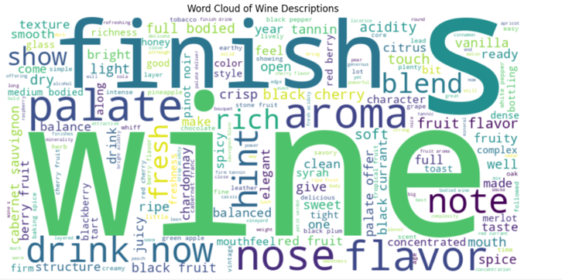
DATASET PROFILE
Post-deduplication, the system retains a vast majority of the 129,971 records.
Price range $4 to $3,300+ and Points range 80-100
Key words: Fruit, Acidity, Tannins, Oak.
Imputation: Median values applied to 8,996 records.

Slide 10
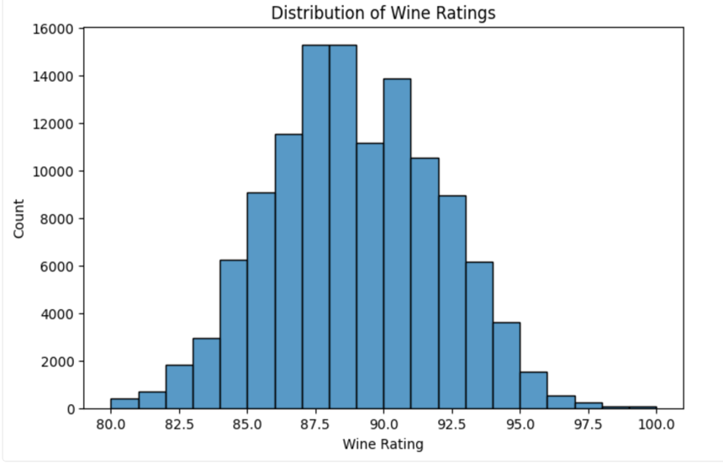
WINE RATING DISTRIBUTION
Centrally Clustered Scoring
Rating scores follow a near-normal distribution typical of critical reviews
Density: Most reviews fall between 85 and 91 points
Elite Status: 95+ points are strictly limited to the top <5% of data.

Slide 11
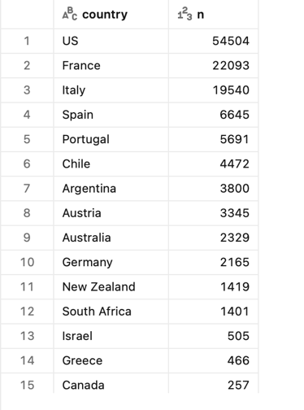
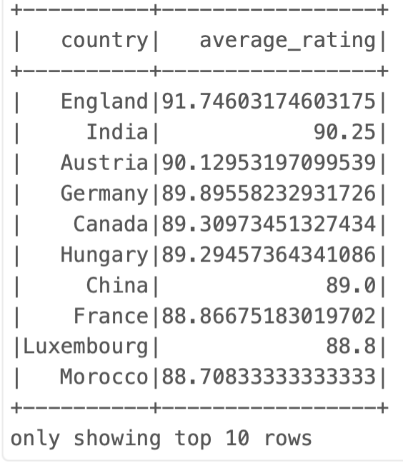

GEOGRAPHIC VOLUME ANALYSIS
Distributed Spark GROUP BY queries identified the dominant players in global criticism:
Major Producers by Volume
United States
~54,500 Reviews
France
~22,000 Reviews
Average rating by Country shows that highest rated wines are from England with ~91 rating
Italy
~19,500 Reviews

Slide 12
PREMIUM VARIETY PERFORMANCE
Top 5 Praise-Earning Combinations (Price >$100)
Rank | Variety Profile | Average Score
01 | Bordeaux-Style White Blend | 94.67 Pts
02 | Portuguese Red | 94.28 Pts
03 | Port | 94.24 Pts
04 | Sparkling Blend | 94.17 Pts
05 | Riesling | 94.04 Pts
Luxury tier pricing consistently correlates with elite scores across all major varieties.

Slide 13
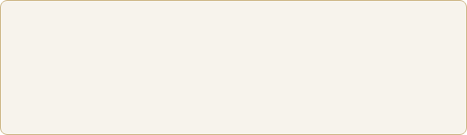
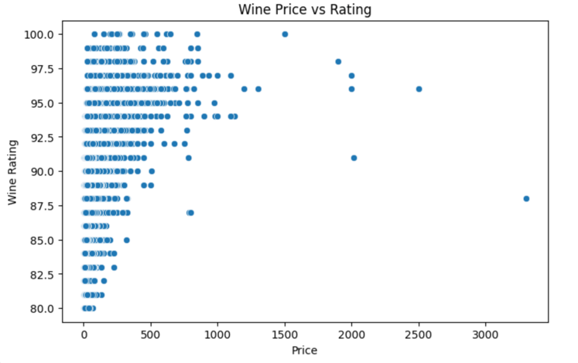
PRICE VS RATING CORRELATION
Scatter plot analysis revealed a significant positive correlation up to $100
Business Case: Investors and retailers should target the $40-$80 "Sweet Spot" for maximum rating stability.
Luxury Median: 91.2 Points
Budget Median: 86.8 Points
Post $100: Variance increases sharply; price no longer guarantees higher points.

Slide 14
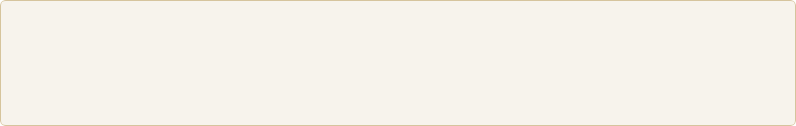






6-STAGE ML PIPELINE
All text transformations are applied identically to training and test data, preventing data leakage.
Fitted pipeline can be applied to any new wine description text
Serialized pipeline model stored in MLflow can be loaded and reused without re-training.
Feature Resolution: 10,000 dimensions used to capture complex flavor compound descriptors.

Slide 15
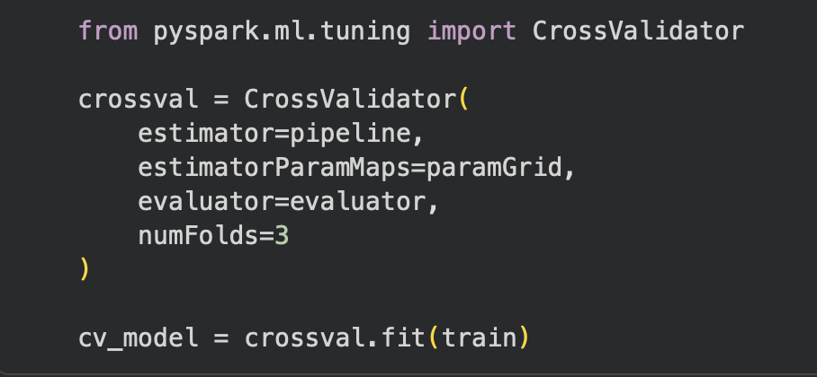

MODEL SELECTION & TRAINING
WHY LOGISTIC REGRESSION?
HYPERPARAMETER TUNING
Logistic Regression was chosen for three key engineering factors:
Implemented using Spark's CrossValidator with a 3-fold split
Training Split: 80%
RegParam: [0.01, 0.1]
MaxIter: [10, 20]
Interpretability: Weights can be mapped directly back to sensory words
Distributed Performance: Trains rapidly on high-dimensional sparse matrices
Scalability: Low inferencing latency for live systems

Slide 16
MLOps Pipeline & Model Management
Production-ready ML workflow with experiment tracking, automated pipelines, and versioned model management.
Experiment Tracking | Automated Pipeline | Model Registry
All training runs logged to MLflow experiment: wine_recommendation_project Metrics recorded including: AUC = 0.9086 Best model stored as a versioned Spark ML artifact | Spark MLlib 6-stage pipeline Ensures consistent preprocessing across CrossValidator folds Trained pipeline can score new wine descriptions with a single transform() call | Full experiment metadata captured: Random seed (42) 80/20 train-test split Hyperparameter grid values Enables model lineage, reproducibility, and rollback to prior versions

Slide 17
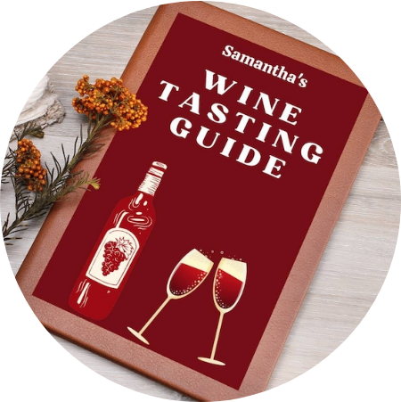
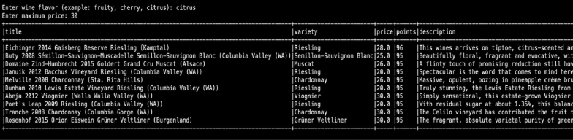
Live Recommendation Engine (PySpark)
Implemented using PySpark DataFrame filtering
Inputs: flavor keyword + price constraint
Output: Top 10 wines ranked by critic score
Demonstrates a real-time analytics use case

Slide 18
STRATEGIC INSIGHTS
Wine Descriptions Predict Quality
NLP classification using only tasting notes achieved AUC = 0.91, showing that reviewer language strongly signals wine quality.
Luxury Wines Receive the Highest Ratings
All top-performing variety–price combinations occurred in the >$100 tier, confirming that the highest critical scores concentrate in luxury wines
Riesling Shows the Most Reliable Premium Quality
Riesling >$100 averaged 94.04 points across 106 reviews, making it the most statistically reliable high-end category.
Citrus-Forward Wines Offer Strong Value Under $30
Filtering for “citrus” descriptors under $30 surfaces wines scoring 95–96 points, highlighting high-value regions like Kamptal, Alsace, and Columbia Valley.

Slide 19




FUTURE IMPROVEMENTS
MongoDB Spark Connector: Replace the PyMongo → Pandas → Spark path with a direct MongoDB Spark Connector integration for true distributed ingestion without a Pandas intermediary.
Transformer-Based Text Embeddings: Replace TF-IDF with sentence embeddings (e.g., BERT, Wine-BERT) to capture semantic relationships between flavor descriptors that sparse bag-of-words methods miss.
Reviewer-Adjusted Scoring: Build a reviewer bias correction model (analogous to adjusted plus-minus in sports analytics) to produce normalized quality scores that are comparable across reviewers and regions.

Slide 20
Thank You

Slide 21
TOOLS & TECHNOLOGIES
Tech Stack | Component | Strategic Role
Databricks | Unified Platform | Compute, Storage & Ingestion
Apache Spark | Core Engine | Distributed ETL and ML Training
MongoDB Atlas | NoSQL Database | Live Data Ingress Source
MLflow 3.10 | Lifecycle Management | Governance & Reproducibility
Python 3.12 | Base Language | Primary Development Layer

Slide 22

RAW DATA SOURCE
MongoDB Atlas Cluster
The source is a cloud-native Cluster0 environment containing 130,000 JSON documents.
Verified Volume: 129,971 records
Reliability: count_documents() verified pre-ingestion
Elasticity: Scalable for future batch updates
DATA INGRESS LAYER

